Slide 1
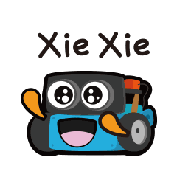
Coding and Autonomous Features
in Automobiles

Slide 2
Notes:
So before jumping into Robot coding, let see how many of you know this women on this screen. Try guessing who she is. (Listen to what students say about Sophia) Meet the famous Sophia, the humanoid robot. She can speak various languages, remember your face, have eye to eye contact and understand your emotions just by looking at you.

Slide 3
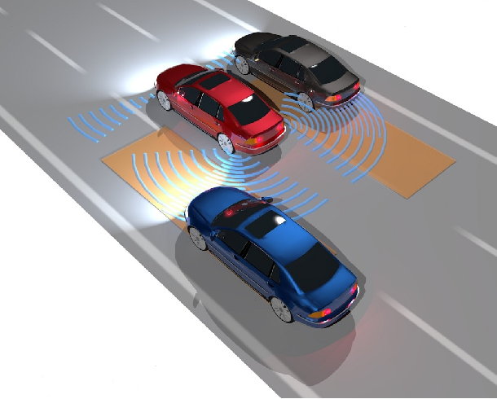
Notes:
Q - What other types of Robots do we have around us?
Do you all know that self driving/ autopilot cars are also one special kind of robot?
Q- Can anyone say whats happening here?
For a car to autonomously drive without human intervention, understanding its surrounding is necessary. In this picture it looks like the red car is trying to understand its surrounding in some interesting way? What is that way exactly?
Robots and Artificial Intelligence are generally created and utilized to mimic naturally existing things in an effective way. In other words their main inspiration is nature.

Slide 4
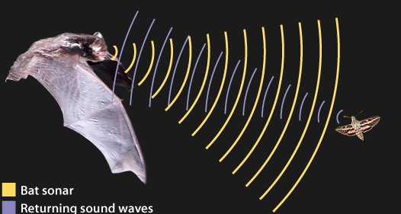
Notes:
Q - How many of you all know Batman
Batman got his name because he hunts in the dark just like a bat. How does a bat find out what is in front of them, a prey or another animal or a wall?
They use ultrasonic sound. Ultrasonic is a sound that is very high pitched that even humans hear. As in the picture, a bat creates an ultrasonic sound and by using the sound waves that are reflected back to them, after hitting a surface, the bat can locate its environment.

Slide 5
Activity # 1: Let’s try echolocation !
Notes:
Humans cannot hear ultrasonic sound but let's see if we can figure out our surroundings without using our eyes and only our ears.
Refer to Lesson Plan for Activity Details

Slide 6
Notes:
Now that we understand echolocation, can anyone explain what the autonomous red car is doing in this picture?
Here, the red car is sending an ultrasonic signal, just like bats, to understand its surroundings. Based on its understanding it will take an action, Stop, steer, slowdown or speedup

Slide 7
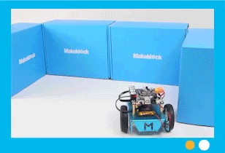
Help Titan Avoid Obstacles on His Path
Notes:
Today we are going to help our mbot, Titan, so I have named him “Titan” but you can decide a nice name for your bot.
Robot coding is simply guiding our bot to achieve a task step by step, In our case, “Obstacle Avoidance” . Our steps should be clear and we should think of all the different possibilities.

Slide 8
Notes:
Robots are complex, and codes are complex. However, there are easier ways that we can learn to code.

Slide 9
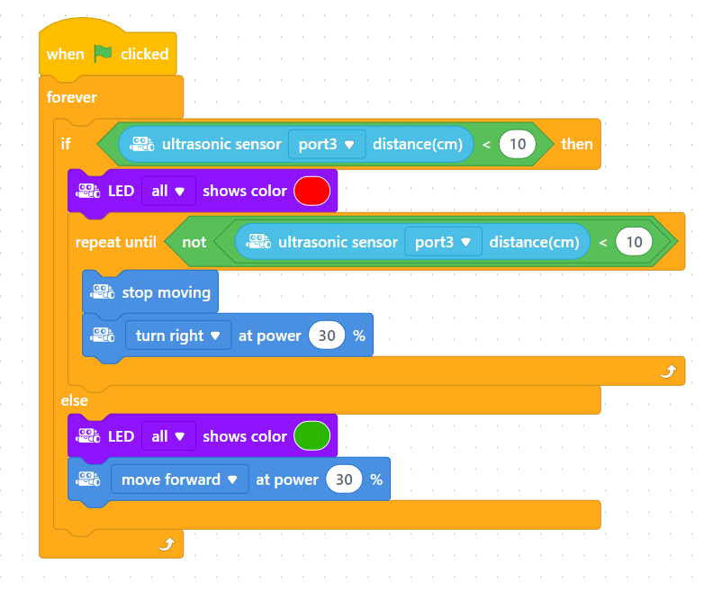
Notes:
This structure is called “Block coding”. This style adds a readable visual layer to multiple lines of code we saw before. It's like a colorful building block isn’t it?

Slide 10
Show
Actions
Sensing
Events
Controls
Operators
Notes:
Different colored blocks are used for different purposes, Lets traverse through each block to see what it is used for!!!

Slide 11
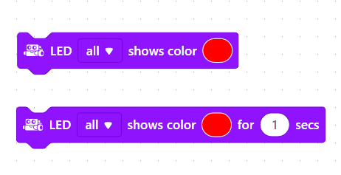
Show
Actions
Sensing
Events
Controls
Operators
Notes:
Purple Show blocks are used to light up LED with different colors

Slide 12
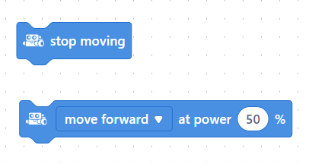
Show
Actions
Sensing
Events
Controls
Operators
Notes:
Dark Blue Actions blocks are used to Make to the bot move in preferred direction and speed

Slide 13
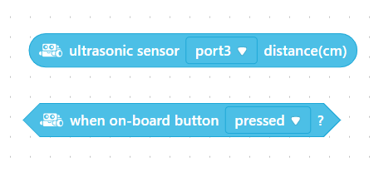
Show
Actions
Sensing
Events
Controls
Operators
Notes:
Light Blue Sensing blocks are used to Manipulate the sensors of the bot

Slide 14
Show
Actions
Sensing
Events
Controls
Operators
Notes:
Yellow Event blocks are used to Set the initial trigger for the Bot, in other words when should our Robot start to work. We might use the second block here, which makes the robot to move when we press this button over here.(show the start button in the mbot)

Slide 15
Show
Actions
Sensing
Events
Controls
Operators
Notes:
Orange Controls blocks are used to Sequence the activities of the Bot and also to add conditions, If a condition is satisfied then do this otherwise do something else, or Repeat some activity until a condition is met, or do something forever. Based on our need we can use one or more blocks of such kind

Slide 16
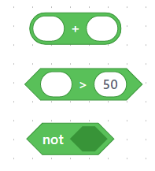
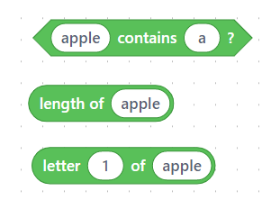
Show
Actions
Sensing
Events
Controls
Operators
Notes:
Green Operators blocks are used simply to add some operations, Here first block shows some mathematical operations, +, -, *, /, >, <, =. “Not” block is used to negate a result. If we put distance = 100 block inside this Not block, result of this combination makes a distance != 100 block.
Second set contains String operations, they are very straight forward, first condition checks is letter “a” is in the word “apple”, second return the “number of letters in the word”, in this case it will return 5, last one returns “1st letter of the word”. “White oval space” like this allows us to use custom values. Here instead of 50 you can add 10 or 20 or whatever you want.

Slide 17
Time to Code
Notes:
Now that we know how to use block code, Lets layout our logic to help “Titan”, and all our bots to avoid obstacles on their way and move ahead. I need one person to impersonate “Titan” we will all help him/her to navigate through obstacles. Are you ready? Let's do it.

Slide 18
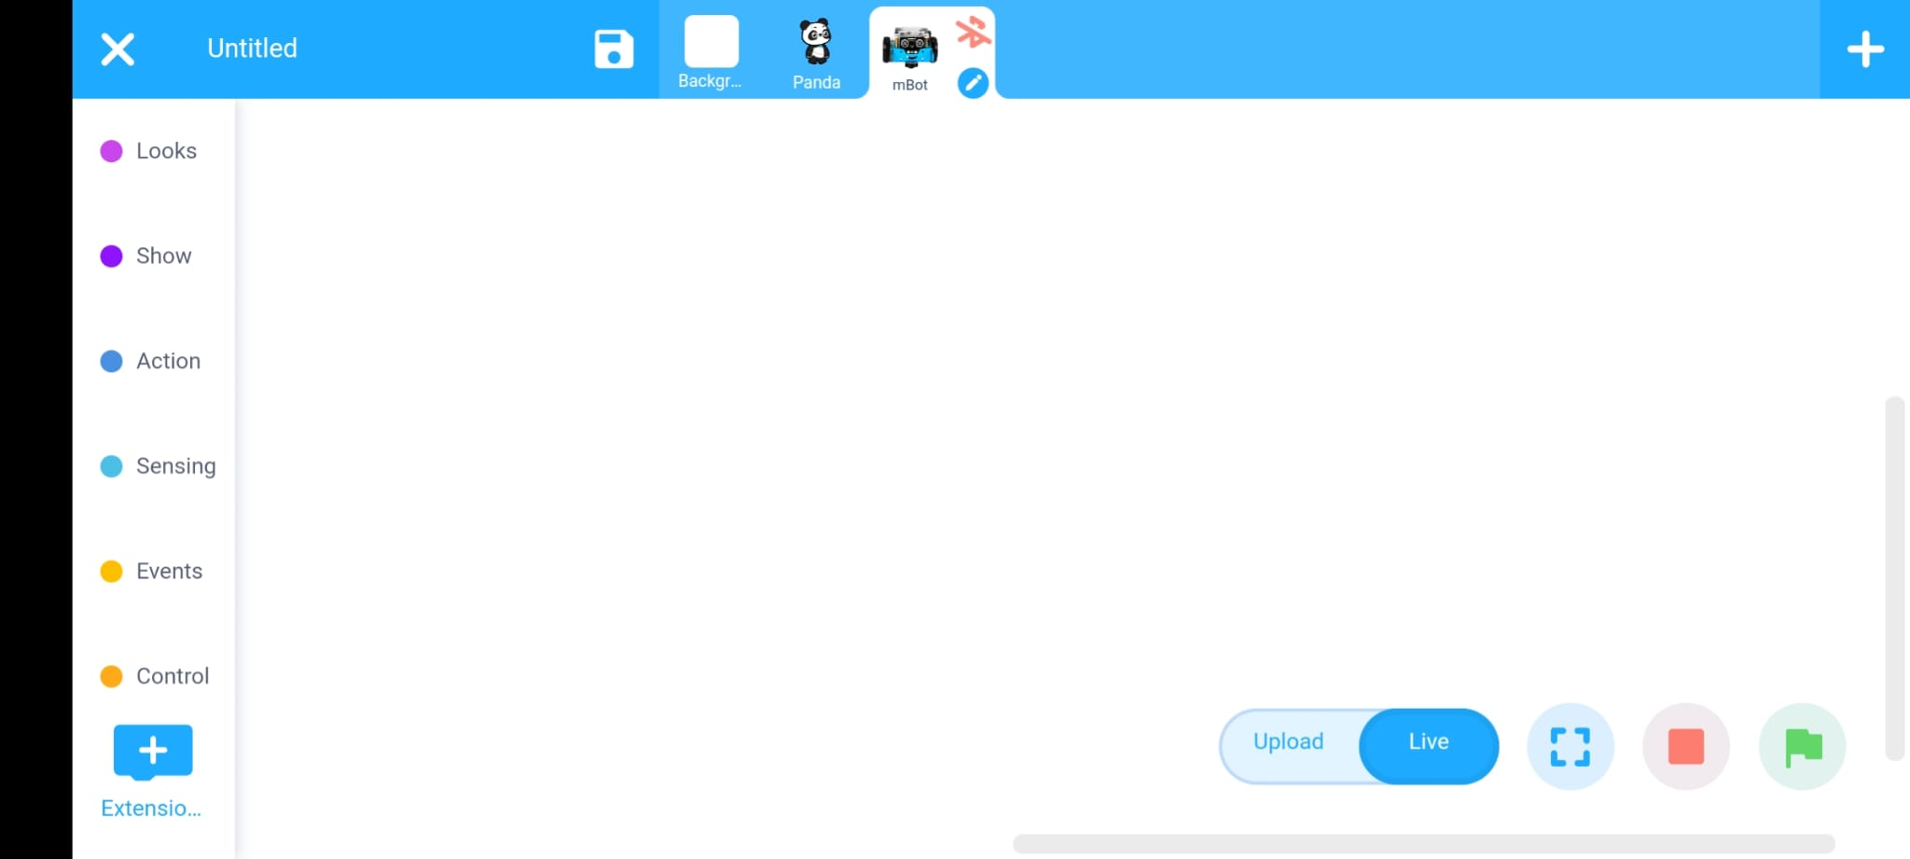
Initial Software Check - 1
1. Make sure “mBot” is selected
3. Tap to connect to mbot
2. Make sure “Live” is selected
Notes:
Before we start the coding we need to do some initial checks make sure our mBot is connected correctly to the app. (take them through the above steps and make sure everyone has connected the app with mBot)

Slide 19
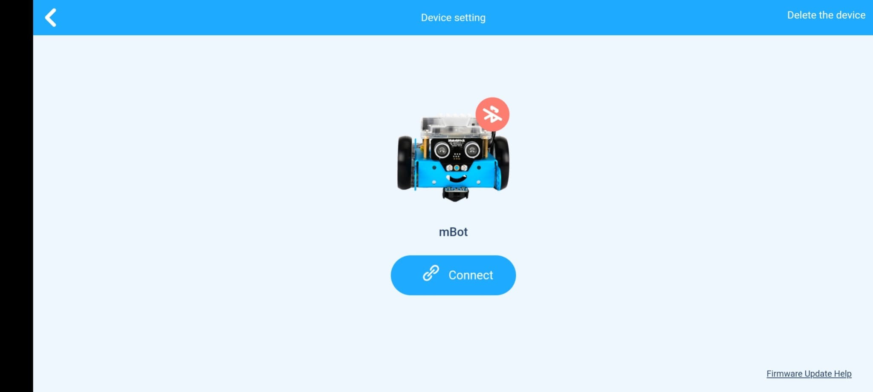
Initial Software Check - 2
Click on “Connect” button
Notes:
(ask them to follow the instruction on screen)

Slide 20
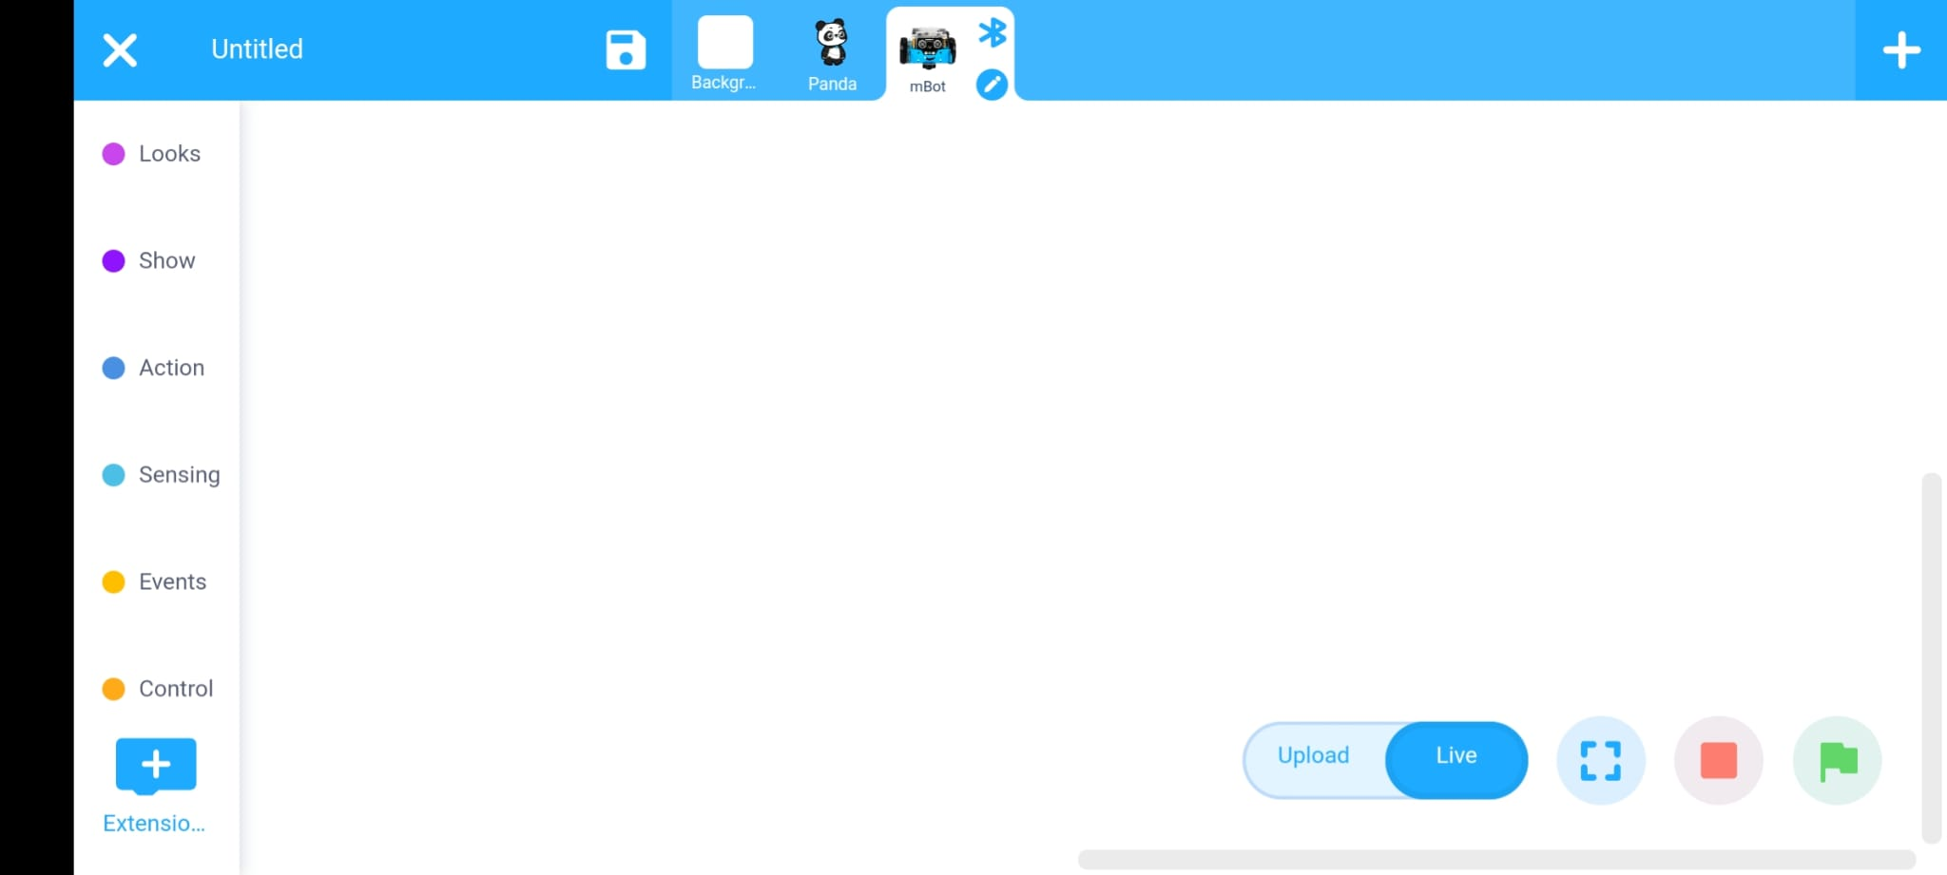
What Do I See On My Screen
Coding Area
Blocks Tab
Start Button
Notes:
Now that we have configured everything, Let’s understand bit about this screen. You will be able to find all the blocks that we saw before in this space(show them the “Blocks Tab” while saying this). Once we finish the coding, you can click/tap this “Upload Button” here to upload your code to your mBot. Whenever you want to use any blocks you just drag and drop them into the “Coding Area” in the middle. That’s all we need to know. Is that clear guys, can we start coding???

Slide 21
Task 1 - Detect Obstacle
If
distance from obstacle < 20cm
[Yes]
[No]
Glow in —--
Glow in —--

Slide 22
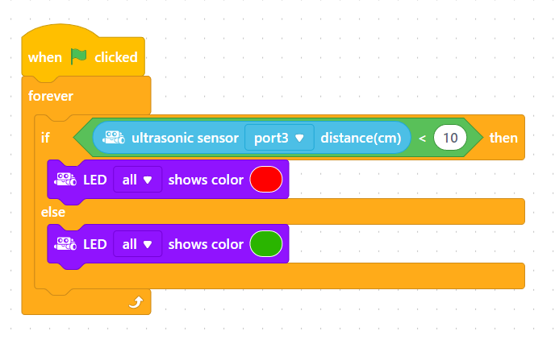

Slide 23
Task 2 - Make movement as per Detection
If
distance from obstacle < 20cm
[Yes]
[No]
Glow in —--
Glow in —--
Stop
Turn right
Move forward
Notes:
Now that we have configured everything, Let’s understand bit about this screen. You will be able to find all the blocks that we saw before in this space(show them the “Blocks Tab” while saying this). Once we finish the coding, you can click/tap this “Upload Button” here to upload your code to your mBot. Whenever you want to use any blocks you just drag and drop them into the “Coding Area” in the middle. That’s all we need to know. Is that clear guys, can we start coding???

Slide 24
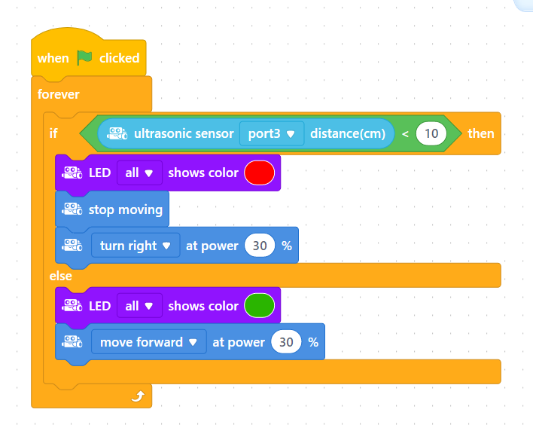

Slide 25
Task 3 - Adapt for Back-to-Back Obstacles
If
distance from obstacle < 20cm
[Yes]
[No]
Glow in —--
Glow in —--
Stop
Turn right
Move forward
Notes:
Now that we have configured everything, Let’s understand bit about this screen. You will be able to find all the blocks that we saw before in this space(show them the “Blocks Tab” while saying this). Once we finish the coding, you can click/tap this “Upload Button” here to upload your code to your mBot. Whenever you want to use any blocks you just drag and drop them into the “Coding Area” in the middle. That’s all we need to know. Is that clear guys, can we start coding???

Slide 27
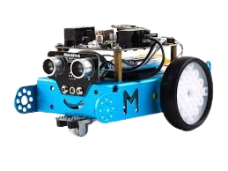
Time to Test

Slide 28
Should we try more

